Slide 1
Bortolotti Simone De Cenzo Davide Marignati Luca
Progetto di Modelli e Architetture Avanzate di DataBase (MAADB)

Slide 2

PROJECT SCHEMA

Slide 3
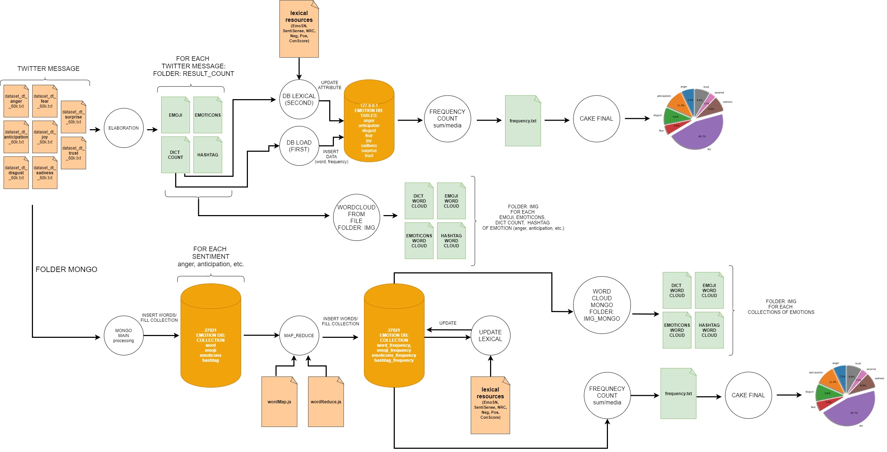

Slide 4
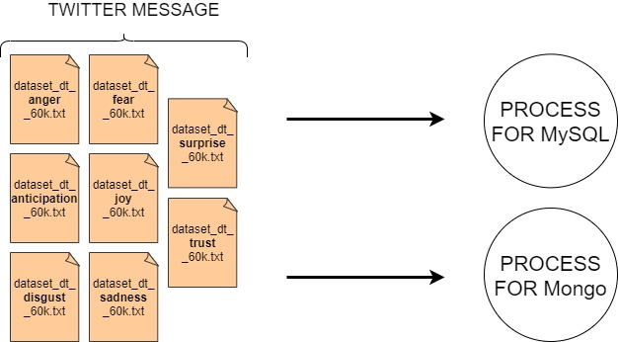

Slide 5
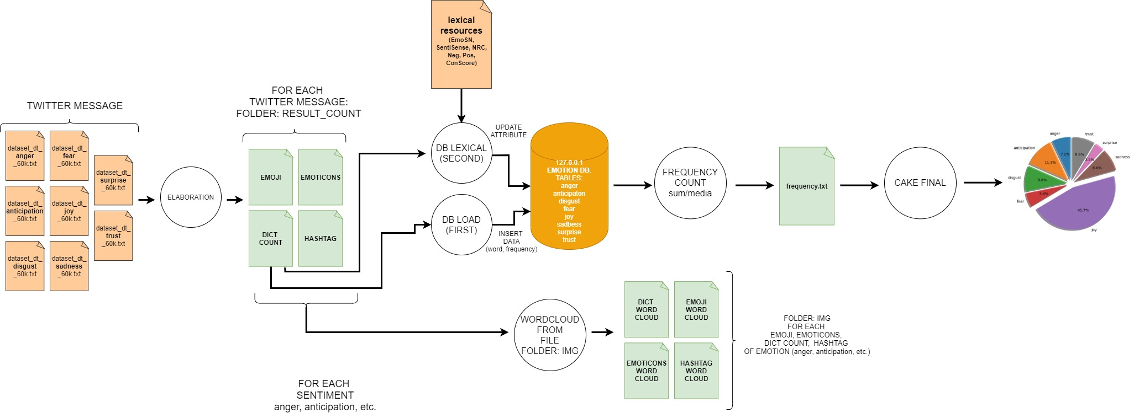
Process for MySQL

Slide 6
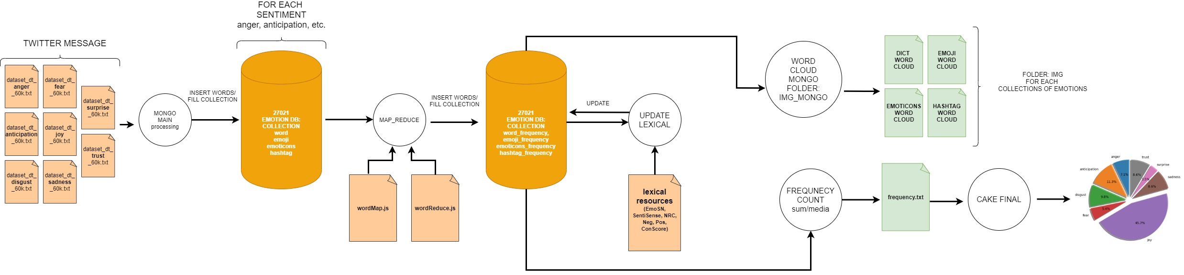
Process for Mongo

Slide 7

FILE SYSTEM

Slide 8
Main folder
archivi_risorse_lessicali
twitter_message
img
img_mongo
4 for each emotion: word + hashtag + emoji + emoticons
result_count
4 for each emotion: word + hashtag + emoji + emoticons
Mongo
E.g. Anger, Anticipation, conScore, etc.
Initial DATASET (e.g. dataset_dt_anger_60k.txt, etc.)
Wordcloud (MySQL)
4 for each emotion: word + hashtag + emoji + emoticons
wordcloud (Mongo collection)
PRE-LOAD DB: results of ELABORATION.PY (NTLK)
Mongo elaboration

Slide 9
Main file (1) - MySQL
ELABORATION.PY
DB_LOAD.PY
DB_LEXICAL.PY
INPUT: twitter message
INPUT: read file from folder «result_count»
INPUT: read file from folder «lexical resources»
processing twitter message (string + nltk operation) + frequency count
save to local array/dictionary (emoji, emotions, hashtag, word)
OUTPUT: save local array/dictionary to file into folder «result_count»
Table = "anger", "anticipation", "disgust", etc.
OUTPUT: insert data to db («emotion»)
OUTPUT: Update table ("anger", "anticipation", "disgust”, etc.)
boolean values (emo_sn, …) + conScore (afinn, ...) + Neg/Pos (gi_neg, …)

Slide 10
Main file (1) - MySQL
FREQUENCY_COUNT.PY
WORDCLOUD_FROM_FILE.PY
INPUT: «select sum from DB»
average calculation
OUTPUT: save to file «frequency.txt»
INPUT: read result count (e.g anger_emoji.txt, etc.)
OUTPUT: save file to folder «wordcloud»
Create wordcloud IMG
4 for each emotion: word + hashtag + emoji + emoticons

Slide 11
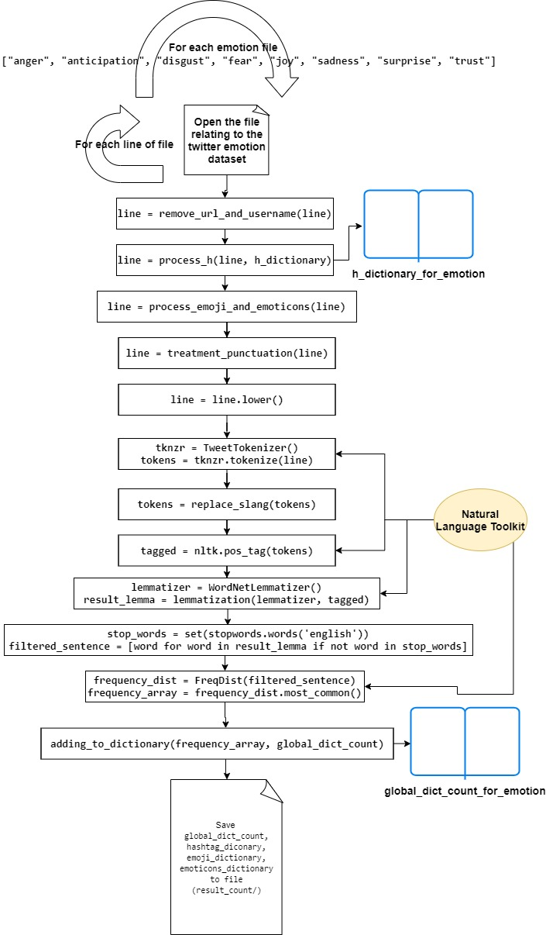
Elaboration.py (1) – example Processing twitter message
(pretty legit) 👌 ❤ 😍 :) @ atm the DISNEY gallery URL #nofilter
(pretty legit) 👌 ❤ 😍 :) @ atm the DISNEY gallery #nofilter
(pretty legit) 👌 ❤ 😍 :) @ atm the DISNEY gallery
(pretty legit) @ atm the DISNEY gallery
pretty legit @ atm the DISNEY gallery
pretty legit @ atm the disney gallery

Slide 12
Elaboration.py (2) – example Processing twitter message
pretty legit @ atm the disney gallery
['pretty', 'legit', '@’, ‘atm’, 'the', 'disney', 'galleries']
['pretty', 'legit', '@’, ‘at the moment’, 'the', 'disney', 'galleries ']
[('pretty', 'RB'), ('legit', 'JJ'), ('@', 'NNP’),
('at the moment', 'VBD’), ('the', 'DT’),
('disney', 'NN'), ('galleries ', ‘NNS')]
TAG | PART OF SPEECH (POS)
JJ | adjective
NNP | proper noun
VBD | verb, past tense took
DT | determiner
NNS | noun, plural
RB | adverbvery, silently
['pretty', 'legit', '@', 'at the moment', 'the', 'disney', 'gallery']

Slide 13
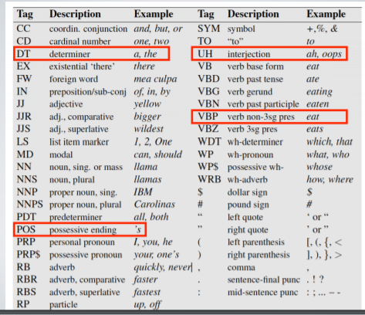
POS TAGGING

Slide 14
Elaboration.py (3) – example Processing twitter message
['pretty', 'legit', '@', 'at the moment’, ‘the’, 'disney', 'gallery']
['pretty', 'legit', '@', 'at the moment', 'disney', 'gallery']
[('pretty', 1), ('legit', 1), ('at the moment', 1),
('disney', 1), ('gallery', 1)]
ADD TO GLOBAL_DICT_COUNT (SUM)
SAVE TO FILE
words, hashtag, emoji, emoticons
for each emotion

Slide 15

Data structure

Slide 16

MySQL

Slide 17
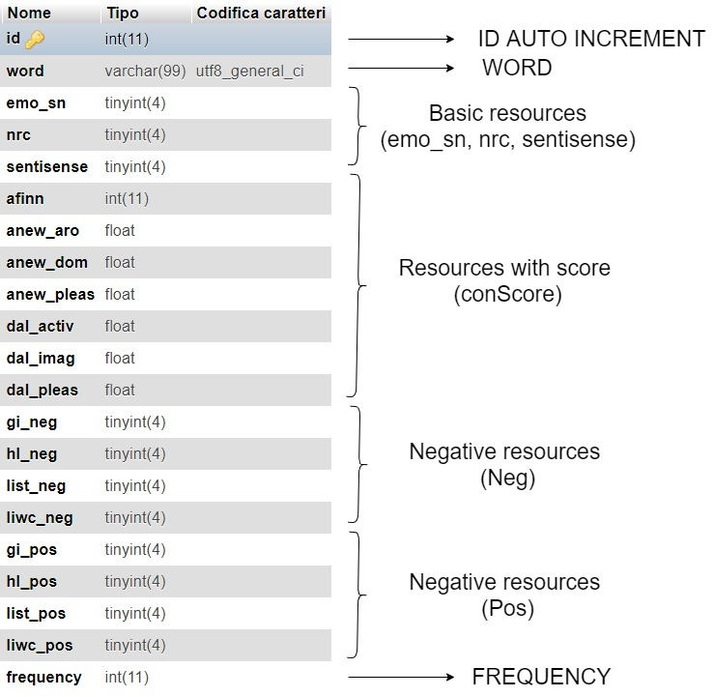
For each emotion: 8 table

Slide 18
Mongo

Slide 19
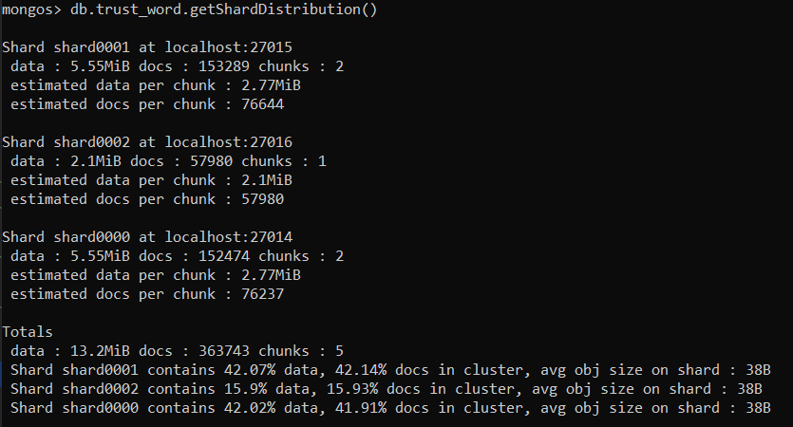
Sharding Data Example Collection: trust_word

Slide 20
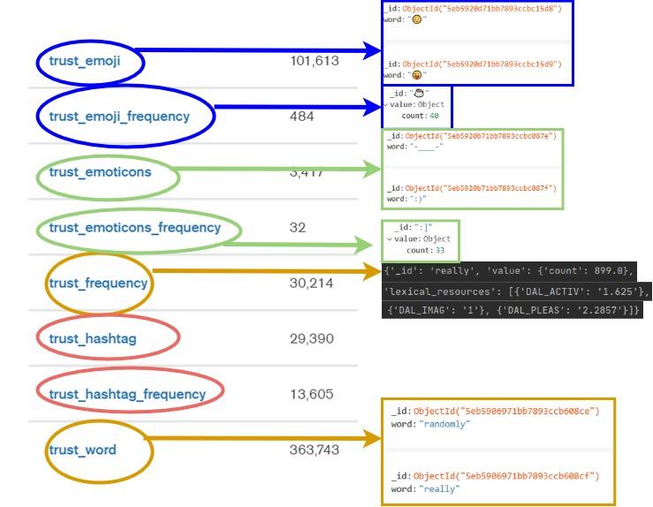
For each
emotion:
8 collection

Slide 21
Document example – word: “Love”
{
'_id': 'love’,
'value': {'count': 10677.0},
'lexical_resources’: [
{'GI_POS': 1}, {'HL_POS': 1}, {'LIST_POS': 1}, {'LIWC_POS': 1},
{'AFINN': '3'}, {'ANEW_ARO': '6.44'},{'ANEW_DOM': '7.11’},{'ANEW_PLEAS': '8.72’},
{'DAL_ACTIV': '2.6364’}, {'DAL_IMAG': '1.4'}, {'DAL_PLEAS': '3’}
]
}

Slide 22
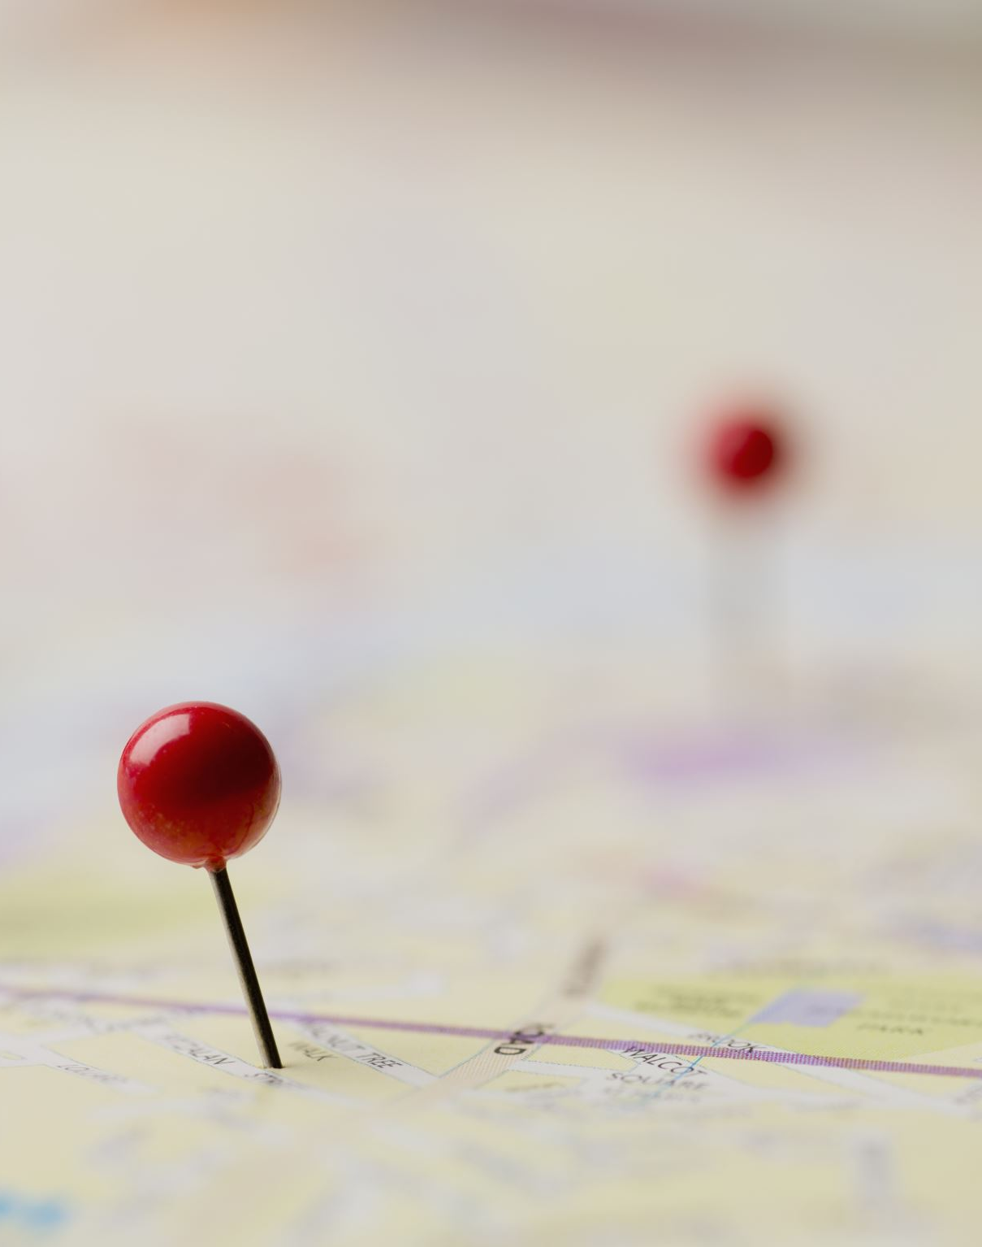
MAP REDUCE

Slide 23
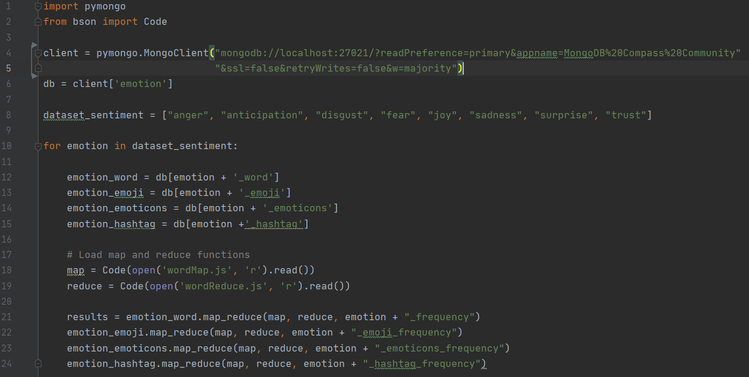
map_reduce (1)

Slide 24
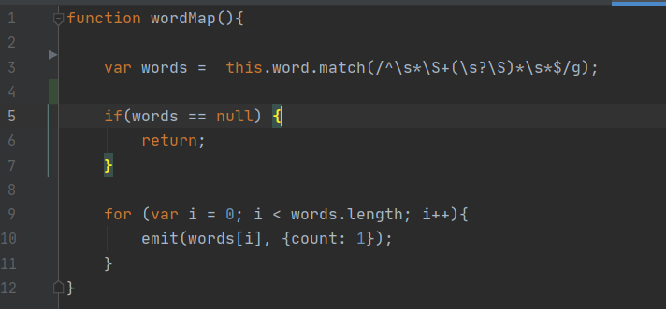
map_reduce (2) wordMap.js

Slide 25
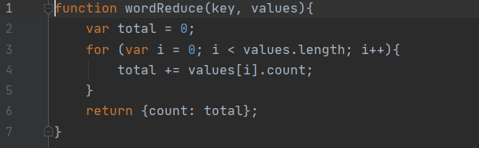
map_reduce (3) wordReduce.js

Slide 26
map_reduce (4)

Slide 27
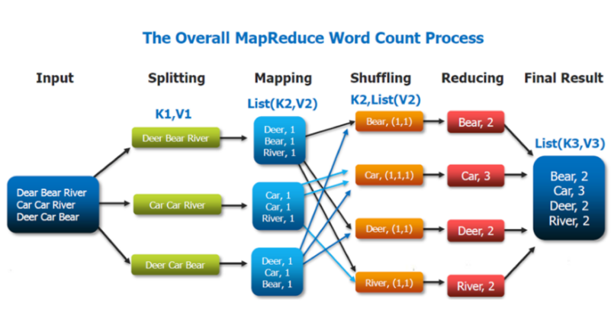
map_reduce (5)

Slide 28

Results

Slide 29
Statistics of use of lexical resources (MySQL/Mongo)
anger:
6.03 %
anticipation: 9.56 %
disgust:
8.27 %
fear:
4.55 %
joy:
38.74 %
sadness: 7.27 %
surprise: 2.96 %
trust:
7.30 %
media = 10.58 %

Slide 30
WORDCLOUD

Slide 31
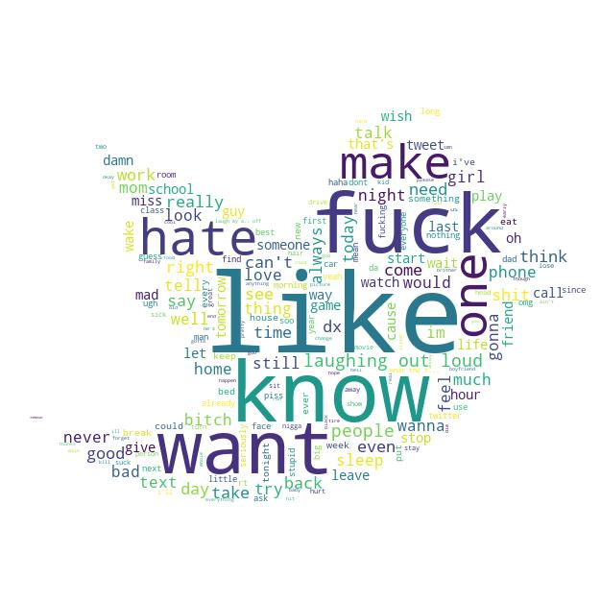

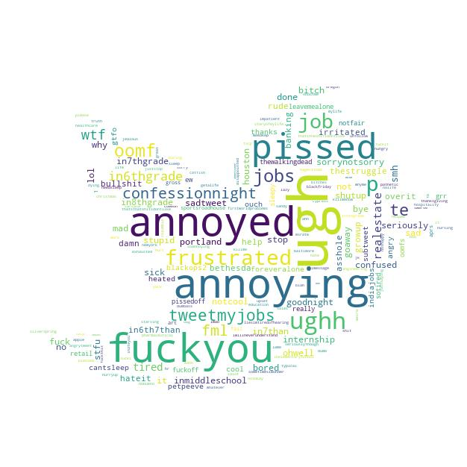

Anger
EMOTICONS
EMOJI
HASHTAG
WORDS

Slide 32
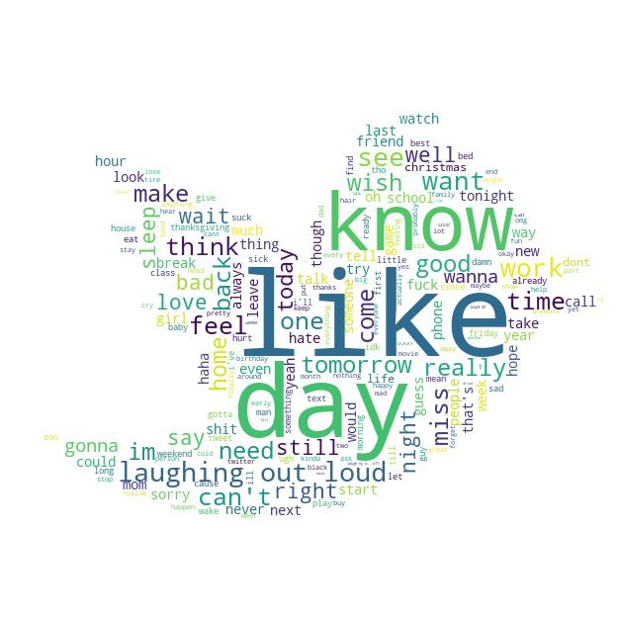
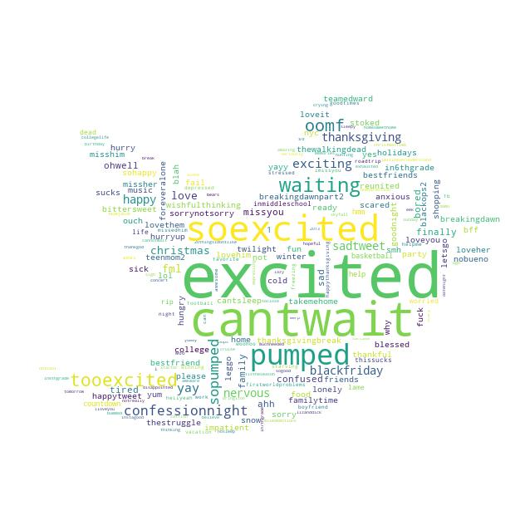

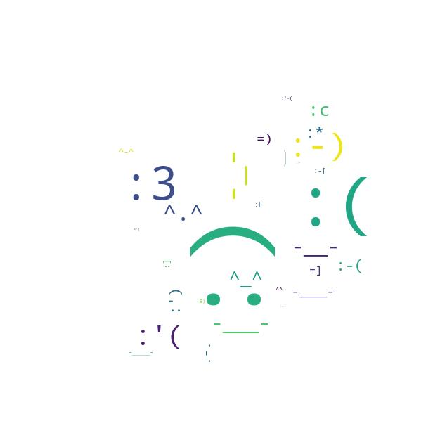
Anticipation
EMOTICONS
EMOJI
HASHTAG
WORDS

Slide 33
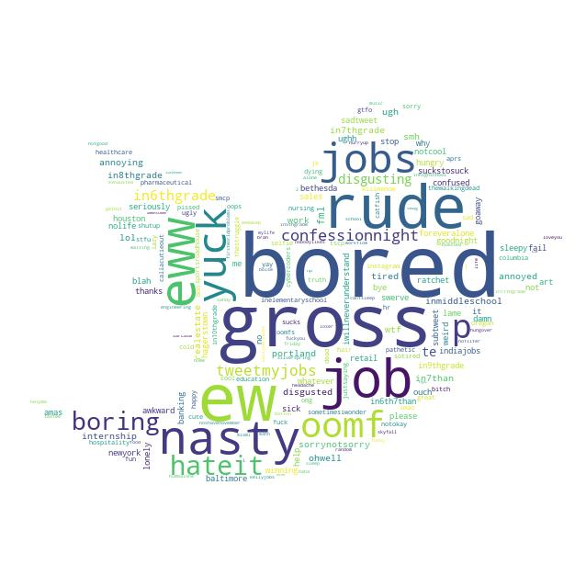

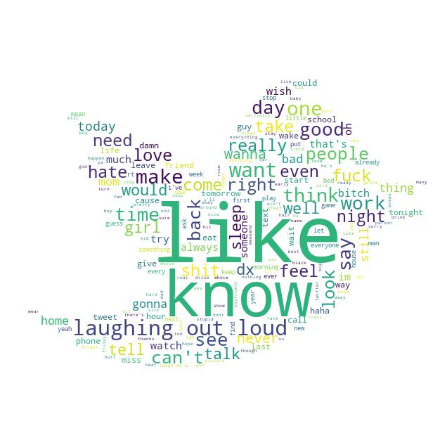
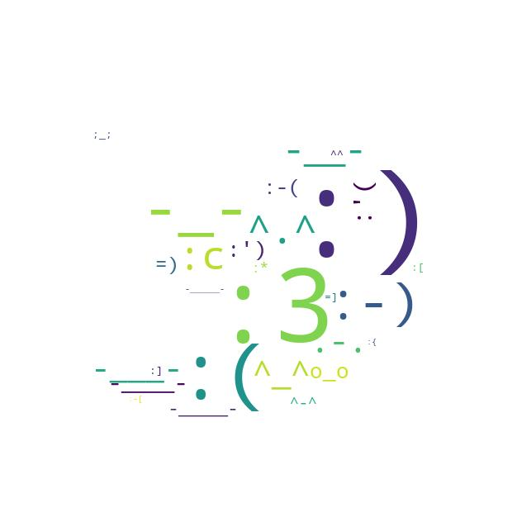
Disgust
EMOTICONS
EMOJI
HASHTAG
WORDS

Slide 34

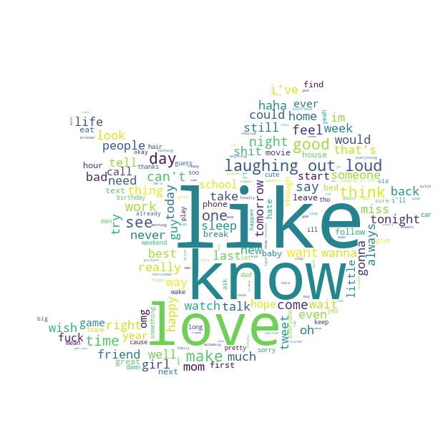
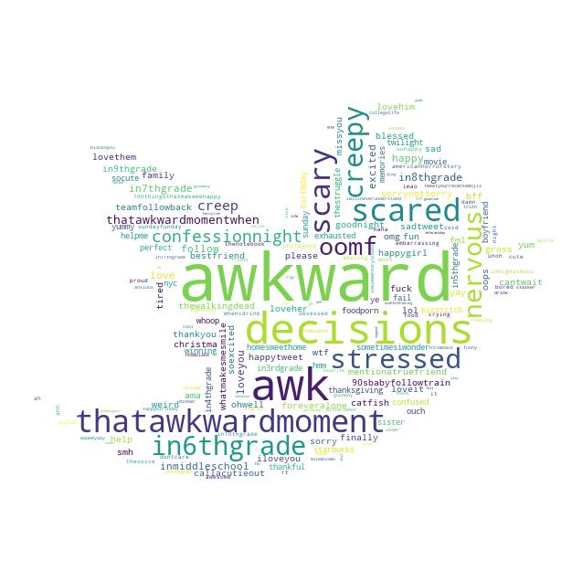
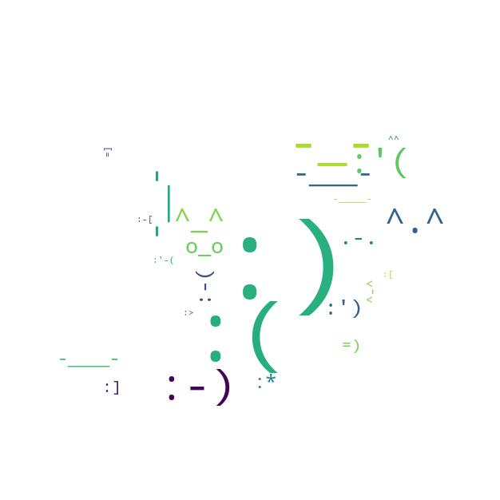
Fear
EMOTICONS
EMOJI
HASHTAG
WORDS

Slide 35
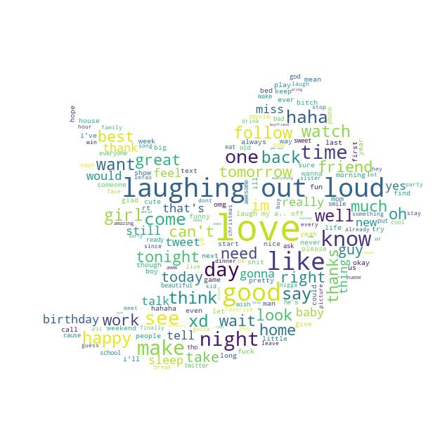
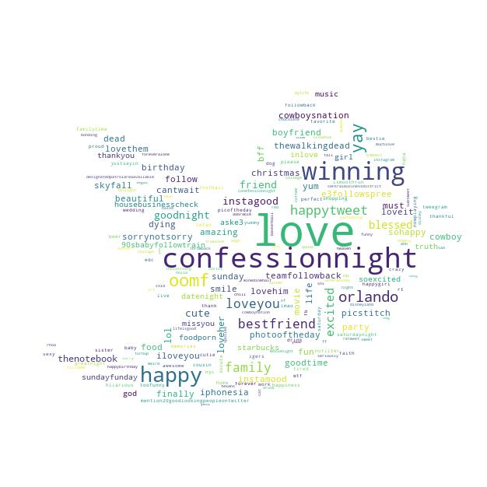

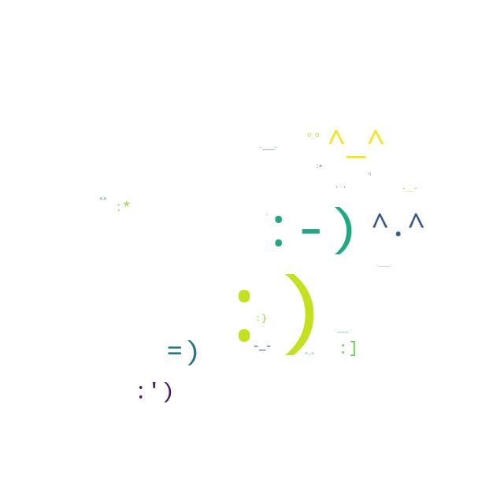
Joy
EMOTICONS
EMOJI
HASHTAG
WORDS

Slide 36
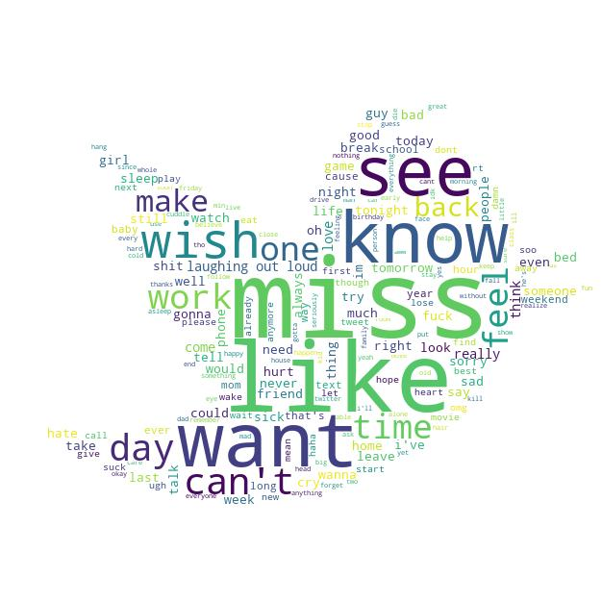

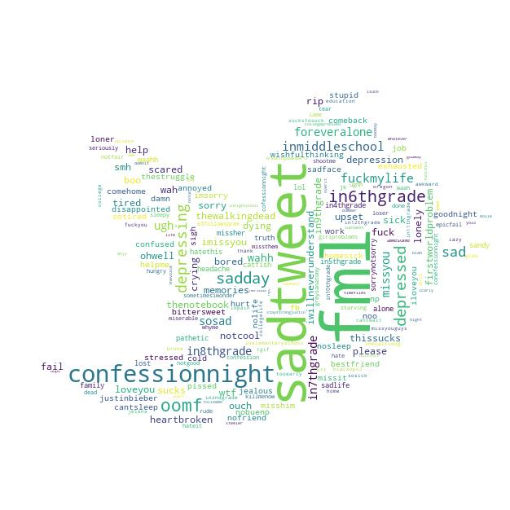

Sadness
EMOTICONS
EMOJI
HASHTAG
WORDS

Slide 37
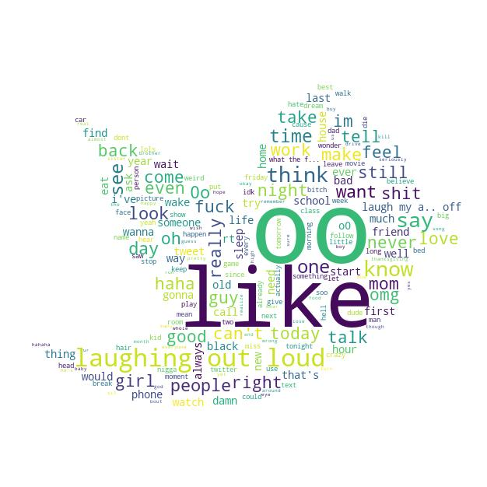
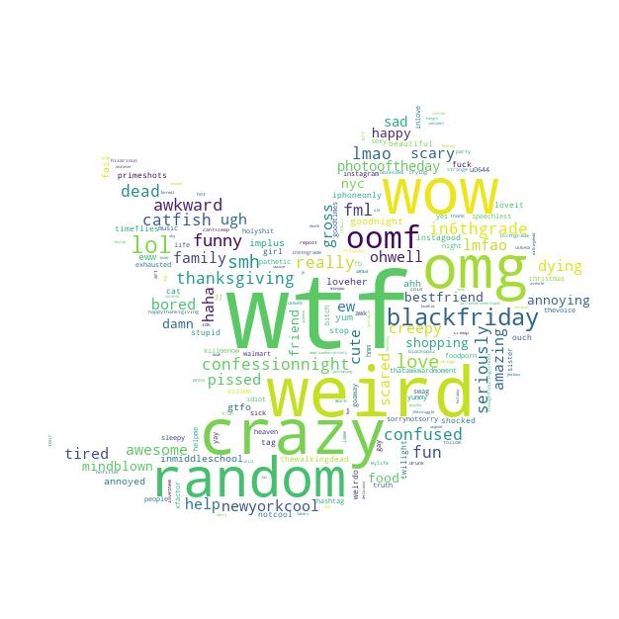

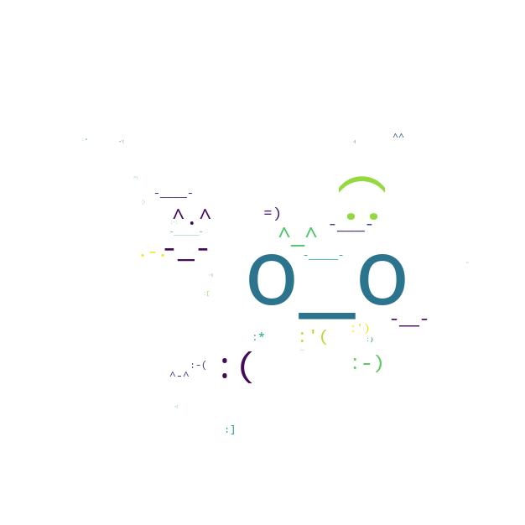
Surprise
EMOTICONS
EMOJI
HASHTAG
WORDS

Slide 38
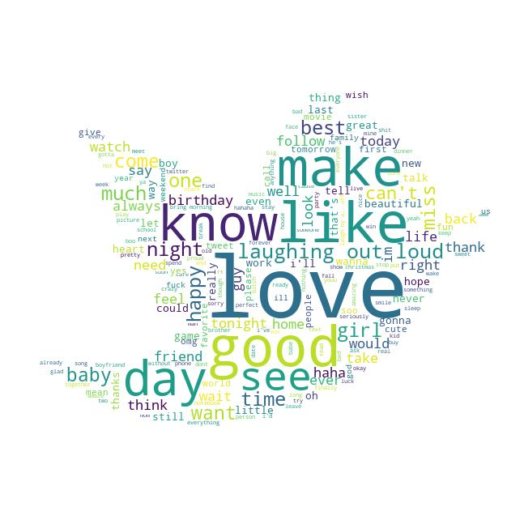
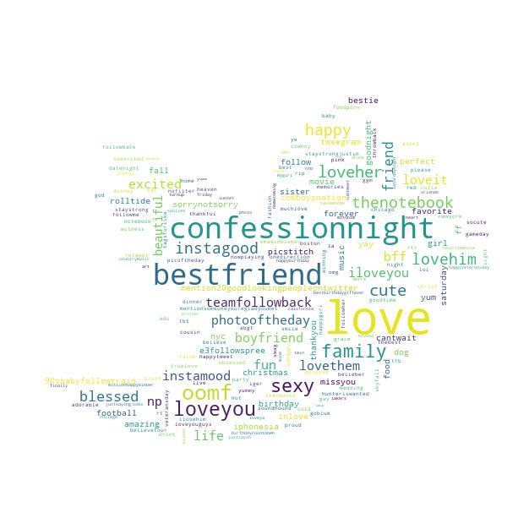

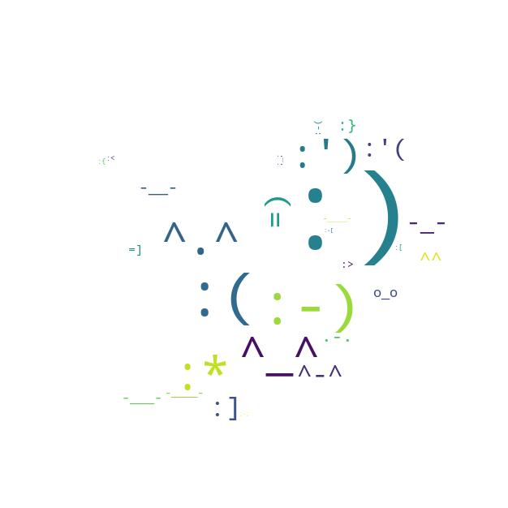
Trust
EMOTICONS
EMOJI
HASHTAG
WORDS

Slide 39
Conclusions

